Slide 1



COURSE INTRODUCTION & ENTREPRENEURIAL SPIRIT
WEEK 1

Slide 2
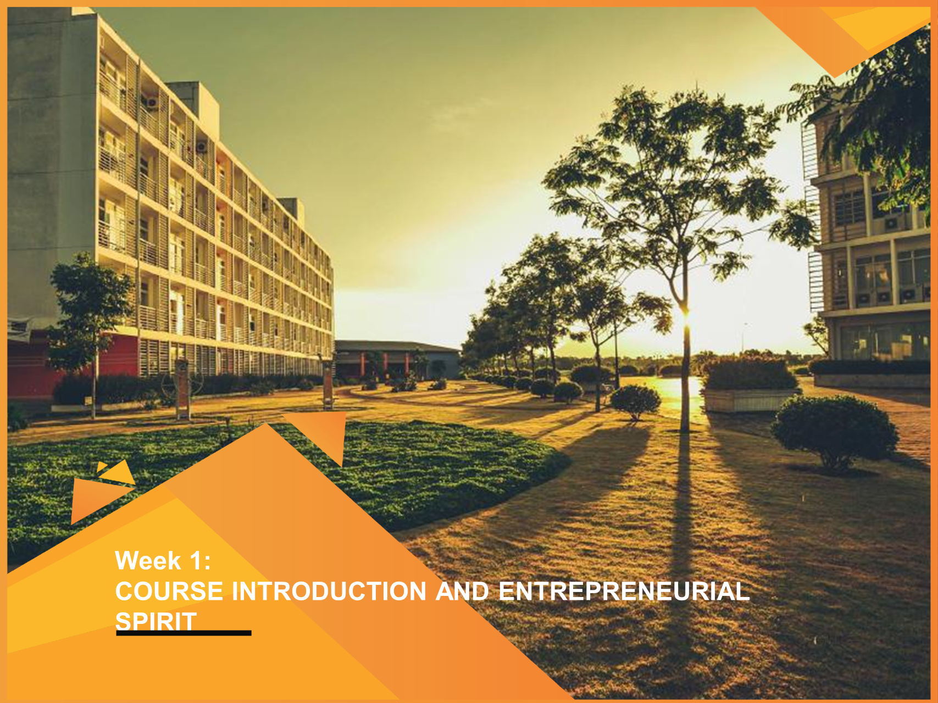
COURSE INTRODUCTION & ENTREPRENEURIAL SPIRIT
WEEK 1

Slide 3
COURSE MISSION
This course focuses on developing your entrepreneurial mindset and introducing you to the underlying concepts and principles that explain entrepreneurship

Slide 4
COURSE LEARNING OUTCOMES
LO1: To understand and verify key entrepreneurship issues at a basic level
LO2: To be able to form the right team and express effective teamwork
LO3: To be able to conduct a survey and make market research based on selected idea
LO4: To be able to build the right product (MVP) and a reasonable business model
LO5: To know how to create a company profile and present it convincingly

Slide 5
LEARNING OBJECTIVES FOR W1 & W2
LO1: Understand the the concept of entrepreneurship and its classification
LO2: Startups definition and successful case studies
LO3: School of thought about entrepreneurship
LO4: The dark side of entrepreneurship
LO5: Forming a winning team

Slide 6
ASSESSMENTS
Name | Content | % Weight | Week Report
Check Point 1 | Team setup, market pain points, solution, and ideas | 10% | W3
Check Point 2 | Market research | 20% | W5
Check Point 3 | Business model (Canvas), Product Prototype (Figma) | 15% | W7
Check Point 4 | Pitch Desk (includes info from CP1 to CP3, and business forecast, valuation) | 40% | W9, then W10 for finalization
In-class constructive questions | Q&A, attendance in classes/seminar, CEO role | 15%

Slide 7
CHECKPOINT 1 & 2
Name | Content | Rubric
Check Point 1 | - In class, by instructor - The class will be divided into groups, each group of 4-6 students from at least 2 different majors. - The group assigns roles to each member, for example, team leader - CEO, in charge of engineering - CTO, in charge of marketing - CMO,... - Each group has the task of finding a startup idea, naming the group, and presenting the business area of that idea. | Present clearly: - The startup idea - Roll of each member's in team - Members are from different fields
Check Point 2 | - In class, by instructor - Identify the problem to be solved and analyze the market: . Survey a group (> 100 people) and interview two experts in their industry. . The team presented market research results and analysis insights related to their business areas, including industry outlook, market size, trends, segments, key players, market share, and product pricing. . The team presented the value proposition for their idea, market fit and compared it with competitors. | Understand and be able to analyze the market pain. Present market research, includes: - Market size/trend - Key players (price, market share, value, insight) - Customer segments,

Slide 8
CHECKPOINT 3 & 4
Name | Content | Rubric
Check Point 3 | Product/solution description: - Encourage each team to have a simple application product (MVP/Prototype) with basic features. - Canvas business model presentation. | - Qualify of the MVP/Prototype - Qualify of the BMC
Check Point 4 | Pitch Desk: Build a complete startup company profile and present it. | Regarding the requirements of the final exam

Slide 9
SPARK AND NURTURE ENTREPRENEURIAL MINDSET

Slide 10
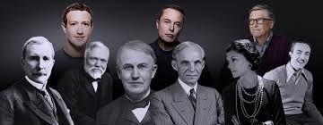
WHO DO YOU THINK OF WHEN YOU HEAR THE WORD “ENTREPRENEURSHIP”?
Do you know where the word “Entrepreneurship” comes from?
The word ‘entrepreneur’ is derived from the French verb entreprendre, meaning ‘to seize, ‘to begin’, ‘to undertake’

Slide 11


DEFINITION OF ENTREPRENEURSHIP
Entrepreneurship is the process of identifying opportunities, creating value, and managing resources to establish and manage a new business or project.
Entrepreneurship is a dynamic process of vision, change, and creation. It requires an application of energy and passion towards the creation and implementation of new ideas and creative solutions.’
(Frederick, Kuratko & Hodgetts, 2007)
See
(Identify)
Act
(Execute)

Slide 12
WHO IS AN ENTREPRENEUR
Undertakes to organize, manage, and assume risks;
Recognizes and seizes opportunities;
Converts opportunities into marketable products/services;
Creates/adds value through time, effort, money, and/or skills;
Realizes the rewards from these efforts.

Slide 13
TWO KINDS ENTREPRENEURS
Business entrepreneurs
Driven by a profit motive – constantly innovating for market share
Social entrepreneurs (Socio-preneurs)
Driven by a mission to fill gaps left by the market and public sector

Slide 14
SOCIOPRENEURSHIP
Sociopreneurship is a form of entrepreneurship that seeks to address social and environmental problems while generating profits.
Solving social problems: poverty, hunger, health, education, and the environment
Improve the economy of an area by creating sustainable businesses
Improve the quality of life by providing access to education, health, and other resources
Source: World Business, 2015
Social Entrepreneurs do not only aim to profit from business but focuses on solving social problems and generating positive social impact. On the other hand, Socio-preneurs still have to maintain business sustainability.

Slide 15
ANOTHER KIND OF BUSINESS PERSON
Small business owners
Prefer a more stable and less aggressive approach
Would rather exploit existing opportunities
Operate in existing markets

Slide 16
BUSINESS ENTREPRENEURS – STARTUPS
A start-up is any business that applies innovative technology-enabled solutions that have the potential to achieve scalability
Source: StarupBlink

Slide 17
BUSINESS ENTREPRENEURS – STARTUPS
Startups primarily confront uncertainties in contrast to established companies implementing predetermined strategies and action plans to address challenging yet familiar difficulties (Blank & Euchner, 2018)
- Unfamiliar client base
- Unexplored distribution channels
- Uncertain pricing model
- Unspecified set of features
Uncertainties
Untested hypotheses that need to be examined

Slide 18
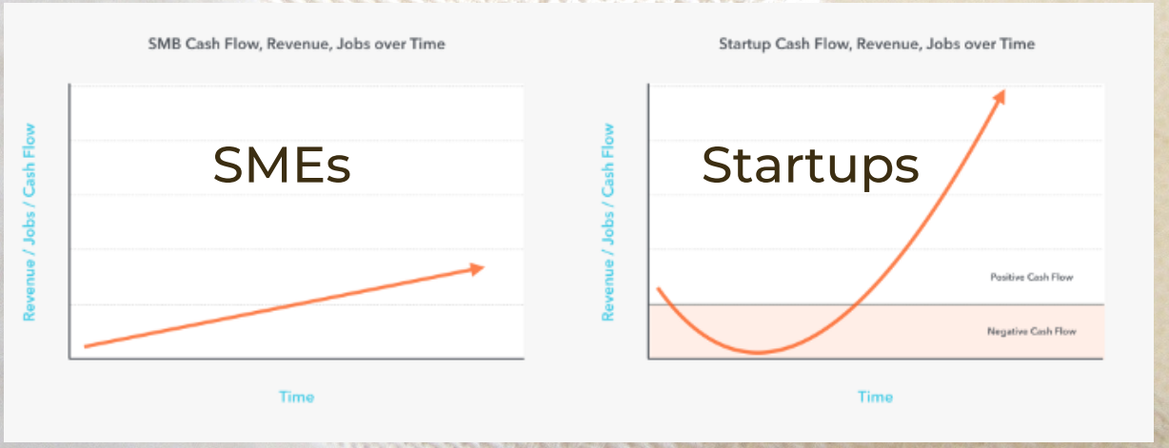
STARTUPS VERSUS SMALL-BUSINESS OWNERS
Startup is about uncertainty and growth

Slide 19


STARTUPS VERSUS SMALL-BUSINESS OWNERS
Innovative products/ services
Uncertainty market and market needs
Startup is structured to cope the uncertainty. Its successful depends on flexibility
Duplicate current business models/ products or services
Products, prices, market needs, segments are proven
Business is established based on profitable investment opportunities. Its successful depends on efficiency

Slide 20
CASE STUDIES
Can you identify the following entrepreneurs and their ventures?

Slide 21
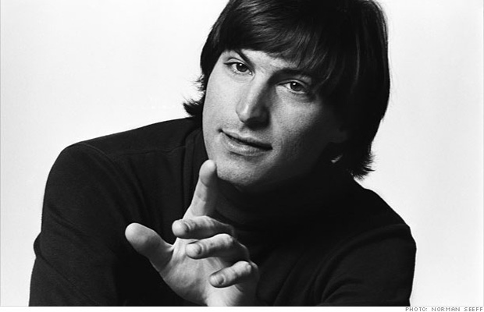
CASE STUDIES

Slide 22

CASE STUDIES
Apple Computer, Inc. was founded on April 1, 1976, by college dropouts Steve Jobs and Steve Wozniak, who brought to the new company a vision of changing the way people viewed computers.
Jobs and Wozniak wanted to make computers small enough for people to have them in their homes or offices. Simply put, they wanted a user-friendly computer.
Later, this vision for computers was passed to the iPod, iPad, and iPhone.

Slide 23
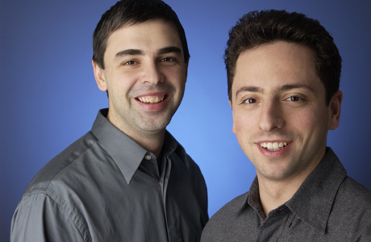
CASE STUDIES

Slide 24

CASE STUDIES
Google was initially a research project that was begun in 1996 by Larry Page and Sergey Brin when they were both PhD students at Stanford University.
In the search for a dissertation theme, Larry Page had been considering exploring the mathematical properties of the World Wide Web, understanding its link structure as a huge graph, and he picked this idea to focus on the problem of finding out which web pages link to a given page.
Source: Google

Slide 25
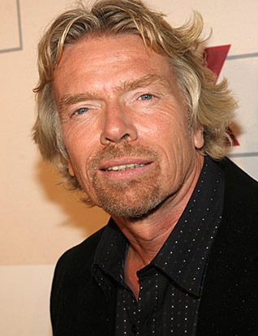
CASE STUDIES
My biggest weakness in life is that I can't say no.

Slide 26

CASE STUDIES
The Virgin brand was born in 1970 when Richard Branson and his friend Nik Powell launched a mail-order record business, a record shop, on Oxford Street in London. Richard later saw an opportunity to create a different recording experience for musical artists, then they acquired a large, rundown manor house in Oxford, and converted it into a recording studio, called The Manor.
After expanding across the music and media scene, Virgin made a big leap into aviation – convinced they could provide people with a better flying experience
Source: Virgin

Slide 27

CASE STUDIES
Muhammad Yunus, a Bangladeshi social entrepreneur and economist
Was awarded the Nobel Peace Prize in 2006 for his pioneering work in microfinance and poverty alleviation.
Revolutionized the concept of microcredit by providing small loans to the poor, particularly women

Slide 28
THEORY: SCHOOLS OF THOUGHT
Macro view
Social and cultural school of thought
Financial/capital school of thought
Displacement school of thought
Ecological school of thought
Source: Frederick et al., 2016
Micro view
Entrepreneurial trait school of thought
Venture opportunity school of thought
Strategic formulation school of thought

Slide 29
MACRO SCHOOLS OF THOUGHT
Social and cultural - focus on external factors and conditions shaping the entrepreneur.
Financial/capital - focus on how to seek seed capital and grow funds.
Displacement – Displace conventional ways of doing things
Ecological - focus on natural systems and constraints; includes ‘green economics’.
Macro view
Source: Frederick et al., 2016

Slide 30
MICRO SCHOOLS OF THOUGHT
Entrepreneurial trait - Traits common to successful entrepreneurs: self-efficacy, proactive personality, tenacity, need for achievement and stress tolerance.
Venture opportunity - Right idea/right time/right market niche: the importance of preparation and awareness.
Strategic formulation - The importance of planning a successful enterprise: leveraging unique, identifiable elements to form a venture.
Micro view
Source: Frederick et al., 2016

Slide 31
KEY TAKEAWAYS FOR W1
KT1: To be able to define the entrepreneurship and its classification
KT2: To be able to differentiate startups with other normal business
KT3: To briefly understand the school of thought about entrepreneurship

Slide 32
REFERENCES
Frederick, H., O'connor, A., & Kuratko, D. F. (2016). Entrepreneurship: Theory, process, and practice. Cengage Learning.
Startupblink (2023), Global Startup Ecosystem Index. Startupblink Reports, Retrieved 2023. https://www.startupblink.com/blog/reports/
Virgin Corporation, https://www.virgin.com/
StartupBlink, https://www.startupblink.com/
Apple Corporation, https://www.apple.com/

Slide 33
WHAT IS RISK
TO BE CONTINUED IN WEEK 2

Slide 34

WHAT IS RISK
TO BE CONTINUED IN WEEK 2

